Slide 1

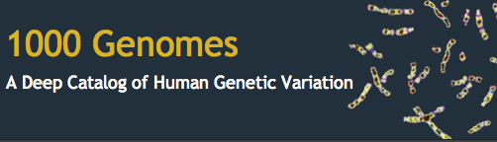
Sequencing workflow
Sequencing
Alignment
Variant calling
Variant annotation
Variant selection
DNA
FASTQ
BAM
VCF
VCF

Slide 2
VCF format
CHROM – chromosome name
POS – reference position
ID – unique identifier(s)
REF – reference allele
ALT – alternate allele(s)
QUAL – quality score
FILTER – “PASS” or list of failed filters
INFO – additional / miscellaneous information
FORMAT – genotype specification
#CHROM POS ID REF ALT QUAL FILTER INFO FORMAT NA00001
20 14370 rs6054257 G A 29 PASS AF=0.5 GT 0|0
20 17330 . T A 3 q10 AF=0.017 GT 1|1
20 1110696 rs6040355 A G,T 67 PASS AF=0.333,0.667 GT 0|2

Slide 3

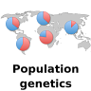

VCF backend
Remote @EBI
Variation database
Data is stored in databases and VCF files
.vcf
Local @home
Use the Ensembl API to
compute allele and genotype counts and frequencies
Linkage disequilibrium
calculated on the fly

Slide 4
We have data from VCF files for:
Human
Mouse
Cow
Sheep
Goat
The details are specified in a configuration file:
ensembl-variation/modules/Bio/EnsEMBL/Variation/DBSQL/vcf_config.json

Slide 5
Tell API to look up data from VCF files
# Create any adaptor from the variation API
# For example create a variation adaptor
my $va = $registry->get_adaptor(‘human’, ‘variation’, ‘variation’);
# Look up data from VCF files and database
$va->db->use_vcf(1)
# Look up data ONLY from VCF files
$va->db->use_vcf(2)

Slide 6
Variation
get_all_SampleGenotypes
get_all_PopulationGenotypes
get_all_Alleles
SampleGenotype
PopulationGenotype
Allele
variation
sample
genotype_string
variation
population
genotype_string
frequency
variation
population
allele
frequency
rs4988235
rs4988235
rs4988235
NA18949
A|A 0.3
A|G
A 0.3
JPT
JPT
Notes:
Experimental results are attached to samples, which are taken from individuals; this supports results from multiple samples from the same individual

Slide 7
Allele
Method | Return type | Example value
$a->allele() | String | G
$a->count() | Int | 34, undef if not defined
$a->frequency() | Float | 0.15, undef if not defined
$a->population() | Population object | Bio::EnsEMBL::Variation::Population, undef if not defined
$a->variation() | Variation object | Bio::EnsEMBL::Variation::Variation
Notes:
Variation get_all_Alleles(population)

Slide 8
SampleGenotype
Method | Return type | Example value
$sg->genotype() @alleles = @{$sg->genotype} | Genotype List reference | [A, C]
$sg->genotype_string() | Genotype String | A|C
$sg->variation() | Variation Object | Bio::EnsEMBL::Variation::Variation
$sg->sample() | Sample Object | Bio::EnsEMBL::Variation::Sample
$sg->sample->individual() | Individual | Bio::EnsEMBL::Variation::Individual
PopulationGenotype
Method | Return type | Example value
$pg->genotype() @alleles = @{$pg->genotype} | Genotype List reference | [A, C]
$pg->genotype_string() | Genotype String | A|C
$pg->frequency() |  | 0.5
$pg->variation() | Variation Object | Bio::EnsEMBL::Variation::Variation
$pg->population() | Population Object | Bio::EnsEMBL::Variation::Population

Slide 9
Projects | Population names | Allele Frequency | SampleGenotype PopulationGenotype
gnomAD | gnomAD | ✓ | ✗
1000 Genomes Project | 1000GENOMES:phase_3 | ✓ | ✓
TOPMed | TOPMed | ✓ | ✗
UK10K | TWINSUK ALSPAC | ✓ | ✗

Slide 10
1000 Genomes Project Allele and Genotype Frequencies
rs4988235
Allele
PopulationGenotype

Slide 11
gnomAD Allele Frequencies
rs4988235
gnomAD VCF file does not contain genotypes. Allele frequencies and counts are taken from the INFO field.

Slide 12
Exercise
Print allele frequencies and allele counts for variant rs4988235
Print only results from the following projects: gnomAD, UK10K and TOPMed
$population_name =~ /gnomad|topmed|twinsuk|alspac/i
Which population reports frequencies for the C allele?
Print only results for the following 1000 Genomes populations: 1000GENOMES:phase_3:FIN, 1000GENOMES:phase_3:CHB, 1000GENOMES:phase_3:ASW
$population_name eq ‘1000GENOMES:phase_3:FIN’
Which population has the highest allele frequency for allele A?

Slide 13
Exercise
Find all samples from population 1000GENOMES:phase_3:ACB with genotype A|G or G|A for variant rs4988235. Print the sample name and the genotype.
$variation->get_all_SampleGenotypes($population);
Print population genotype frequencies and counts observed in 1000GENOMES:phase_3:ACB for variant rs4988235.
$variation->get_all_PopulationGenotypes($population)

Slide 14
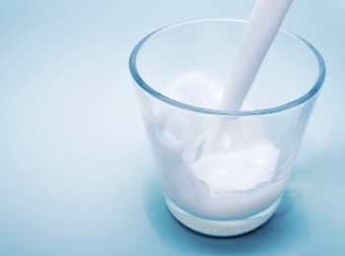
Lactose intolerance
rs4988235: a SNP near the LCT gene controls whether lactase enzyme is turned on or off as a person grows older
Alleles: G/A
ALL
AFRICAN
AMERICAN
EAST ASIAN
EUROPEAN
SOUTH ASIAN
Genotype | What does it mean
G/G | Likely to be lactose intolerant.
G/A | Likely to be tolerant due to lactase persistence.
A/A | Lactose tolerant
Notes:
rs4988235: a SNP near the LCT gene controls whether lactase enzyme is turned on or off as a person grows older.
Alleles: G/A

Slide 15
Phenotype data
Trait
Can be described or measured
Final product of many molecular and biochemical processes
Phenotype: Observed state of the trait
Understand genotype to phenotype link

Slide 16
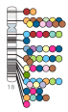

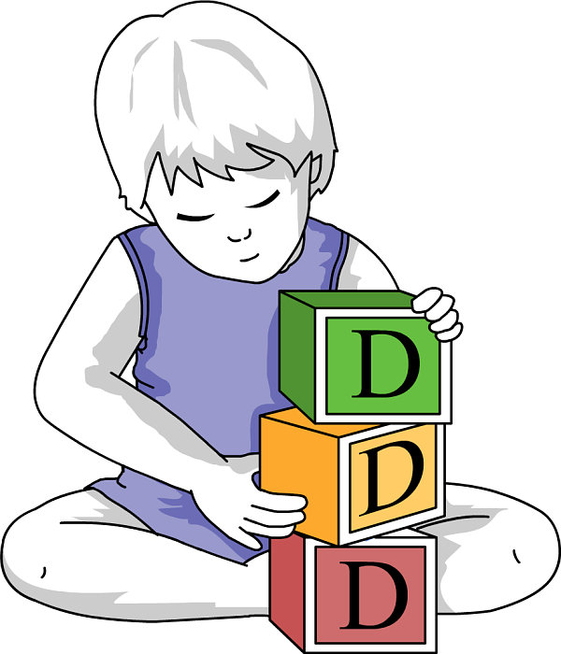



NHGRI-EBI
GWAS
Catalog
Feature
Phenotype, Trait, Disease
Attributes
Genomic Location
Gene
Variant
QTL
Structural variant
Description: as provided by the source
Clinical significance
Reported genes
Most associated risk allele
P-value
Inheritance type
Beta coefficient
PhenotypeFeature
Notes:
Attributes are defined depending on the associated feature
Attributes are not always defined for a PhenotypeFeature

Slide 17
Data available by species
Feature type
Gene | 47736 | 154,588 | 64,619 | 41 | 132 | 26 | 41 | 50,788
Variant | 4,978,589 | 0 | 0 | 0 | 0 | 0 | 0 | 0
StructuralVariant | 116,854 | 0 | 0 | 0 | 0 | 0 | 0 | 0
QTL | 0 | 0 | 2,266 | 4,723 | 100,171 | 17,588 | 1,072 | 0
Sources | 17 | 2 | 1 | 3 | 3 | 3 | 3 | 1

Slide 18
Phenotypes linked to rs2470893

Slide 19
The naming problem
Different sources describe the phenotypes/ diseases in different ways
We need to normalise the descriptions for easy querying
Also need to respect the original data
Features are often reported as associated with a disease sub type making it complex to extract all loci of interest

Slide 20
The solution
Use phenotype and disease ontologies to organise descriptions and allow query and display by synonym and child/parent term.

Slide 21
Import and mapping process
Import phenotype descriptions + features
All descriptions
Zooma exact match
Unmapped descriptions
OLS exact match on full string
Unmapped descriptions
OLS exact match on partial string
https://www.ebi.ac.uk/spot/ontology/
Notes:
Import phenotype descriptions + features
Zooma exact match on EVA data
OLS exact match on full string
OLS exact match on partial string

Slide 22
Ontology mappings
rs2470893
http://www.ensembl.org/Homo_sapiens/Variation/Phenotype?r=15:74726608-74727608;v=rs2470893;vdb=variation;vf=1851694

Slide 23
PhenotypeFeature
Method | Return type | Example value
$pf->type() | String | Gene, Variation, StructuralVariation, QTL
$pf->object_id() | String | Feature name e.g. rs2470893
$pf->phenotype() | Phenotype Object | Bio::EnsEMBL::Variation::Phenotype
$pf->phenotype->description | String | Caffeine consumption
$pf->source() | Source Object | Bio::EnsEMBL::Variation::Source
$pf->source->name | String | NHGRI-EBI GWAS catalog
$pf->associated_gene() | String | CDKN2BAS,NOTCH2
$pf->risk_allele() | String | C
$pf->p_value() | Float | 6e-07
$pf->get_all_ontology_accessions | Arrayref of String | [EFO:0004330, EFO:0006782]
$pf->seq_region_name() | String | 15, X
$pf->seq_region_start() $pf->seq_region_end() | Int | 74727108 74727108
Notes:
object_id () = variant ID or gene name, type,
EFO:0004330, EFO:0006782
rs2470893

Slide 24
Add ontologies
# Create a PhenotypeFeature adaptor
# For example create a variation adaptor
my $pfa = $registry->get_adaptor(‘human’, ‘variation’, ‘PhenotypeFeature’);
# Add ontology mappings to the output
$pfa->_include_ontology(1);

Slide 25
Exercise
After reading a publication about the first genome-wide association study of habitual caffeine intake you want to collect all phenotype data that has been linked to rs2470893.
Fetch all PhenotypeFeatures for variation rs2470893
For each PhenotypeFeature print phenotype description, source name, risk allele, p-value and ontology accessions
You want to study all features that have been linked to coffee consumption (phenotype accession = EFO:0007872)
Fetch all PhenotypeFeatures for phenotype accession EFO:0007872
For each PhenotypeFeature print type, object_id, phenotype description and source name. You can use fetch_all_by_phenotype_accession_source without providing a source

Slide 26
Linkage Disequilibrium
C/T
C/G
Nonrandom association of alleles at different loci
LD is a population-specific measurement
African
American
East Asian
European
South Asian

Slide 27
v₁
v₂
v₃
v₄
v₅
Individual₁
Individual₂
Individual₃
Individual₄
A
T
G
Individual₅
C
Score:
0-0.2
0.2-0.5
0.5-0.8
0.8-1.0
Notes:
Haplotypes of 5 individuals over 5 different loci 1-5
Each loci has 2 alleles

Slide 28
LD calculation
p_{AB}
Allele | A | a | probability
B | p_{AB} | p_{aB} | p_{B}
b | p_{Ab} | p_{ab} | p_{b}
probability | p_{A} | p_{a} | 1.0
p_{A}
A
B
p_{B}
Chr copy 1
Chr copy 2
p_{a}
a
b
p_{b}
p_{ab}
Haplotype frequencies: p_{AB}, p_{ab}, p_{Ab}, p_{aB}
Allele frequencies: p_{A}, p_{B}, p_{a}, p_{b}
LD = observed - expected
D = p_{AB} – p_{A}p_{B}
|D’| = D/D_{max}
r² = D²/p_{A}p_{a}p_{B}p_{b}

Slide 29
Interpreting LD values D’ and r²
High D’ and high r²
Tendency to the presence of only 2 haplotypes, small difference in allele frequency of coupled alleles
High D’ and low r²
Tendency to the presence of only 3 haplotypes, different allele frequencies of the coupled alleles
Low D’ and low r²
Tendency toward random coupling of alleles and presence of all 4 haplotypes

Slide 30
LDFeatureContainerAdaptor
# Create LDFeatureContainerAdaptor
my $ldfca = $registry->get_adaptor(‘human’, ‘variation’, ‘LDFeatureContainer’);
# TODO fetch population object
# Compute LD in a region
# TODO fetch slice object for your region
my $ld_feature_container = $ldfca->fetch_by_Slice($slice, $population);

Slide 31
LDFeatureContainerAdaptor
# Create LDFeatureContainerAdaptor
my $ldfca = $registry->get_adaptor(‘human’, ‘variation’, ‘LDFeatureContainer’);
# TODO fetch Population object
# Compute LD for a VariationFeature and all surrounding
# VariationFeatures that lie within a given window size
# max window size is XXX, default window size is XXX
# TODO fetch VariationFeature object
my $ld_feature_container = $ldfca->fetch_by_VariationFeature($vf, $population);

Slide 32
LDFeatureContainer
Container of pairwise LD values
Calculated on the fly (using a script written in C)
Use $ldfc->get_all_ld_values to get all computed LD values that are stored in the container $ldfc
get_all_ld_values returns an array reference of hash references
foreach my $ld_result (@{$ldfc->get_all_ld_values}) {
print $ld_result->{r2}, “\n”;
…
}
Key | Value
variation1 | VariationFeature object of one of the two variations used for the calculation
variation_name1 | String value
variation2 | VariationFeature object of the second variation used for the calculation
variation_name2 | String value
r2 | 0 to 1
d_prime | 0 to 1

Slide 33
LD populations
# Create Population adaptor
my $pa = $registry->get_adaptor(‘human’, ‘variation’, ‘Population’);
my $ld_populations = $pa->fetch_all_LD_Populations();
foreach my $ld_population (@$ld_populations) {
my $name = $ld_population->name;
my $description = $ld_population->description;
print “$name $description\n”;
}
Notes:
my $ld_populations = $population_adaptor->fetch_all_LD_Populations;
foreach my $ld_population (@$ld_populations) {
print $ld_population->name, ' ', $ld_population->description, "\n";
}

Slide 34
Exercise
LD in a region fetch_by_Slice($slice, $population)
Compute all LD values for the region chromosome 12 between 11053716-11073715 and population 1000GENOMES:phase_3:CEU
Only print results where D’ = 1 and r² = 1. Print D’ (d_prime), r² (r2), variation_name1 and variation_name2
LD for a variation feature fetch_by_VariationFeature($vf, $population)
Compute all LD values for rs7304579 and population 1000GENOMES:phase_3:YRI
Get the VariationFeature for rs7304579
Print all results. Print D’ (d_prime), r² (r2), variation_name1 and variation_name2
Notes:
Compute LD for all variants located on chromosome 12 between 11053716-11073715 for 1000GENOMES:phase_3:CEU, 1000GENOMES:phase_3:CHB and 1000GENOMES:phase_3:YRI • Repeat the computation. But now set D’ and r2 thresholds to 1.
$ld_feature_container_adaptor->db->use_vcf(1);

Slide 35
Structural Variation
Usually represents a large segment of variable DNA sequence (> 1kb)
Different processes give rise to different types of structural variations:
Copy number variation (CNV)
Inversion
5'
3'
3'
5'
→ Allele type “Gain”
Duplication
Translocation

Slide 36
Example of a Structural Variant
Structural variant: nsv917561
Variation class | CNV (SO:0001019)
Source | DGVa – Database of Genomic Variants Archive
Study | nstd75 – “International Standards for Cytogenomic Arrays Consortium (prenatal dataset).” PMID:21844811, PMID:20466091
Location | Chromosome 1:146987841-148359881 (forward strand)
Supporting evidence
Supporting evidence | Chr:bp (strand) | Allele type | Clinical significance | Individual name
nssv1605931 | 1:146987841-148359881 (+) | Gain | pathogenic | ISCA_ID_pn_1622
nssv1606072 | 1:146987841-148359881 (+) | Gain | - | ISCA_ID_pn_1746

Slide 37
http://www.ensembl.org/Homo_sapiens/StructuralVariation/Explore?sv=nsv917561

Slide 39
StructuralVariation
Method | Return type | Example value
$sv->variation_name() | String | esv214236
$sv->var_class() | String | CNV
$sv->study() | Study object | Bio::EnsEMBL::Variation::Study, undef if not defined
$sv->get_all_SupportingStructuralVariants() | Listref of objects | [Bio::EnsEMBL::Variation::SupportingStructuralVariation]

Slide 40
Supporting structural variation
StructuralVariation
get_all_StructuralVariationFeatures
get_all_SupportingStructuralVariants
StructuralVariationFeature
SupportingStructuralVariation
Region of the genome that a submitter has defined as containing structural variations.
Actual variant calls that were made within a study.

Slide 41
Structural variation coordinates
Usually a structural variation has only a start and an end
But sometimes, the breakpoint locations cannot be determined precisely
outer
start
inner
start
inner
end
outer
end
start uncertainty
end uncertainty

Slide 42
StructuralVariationFeature
Can be retrieved from the StructuralVariationFeature adaptor and the StructuralVariation object
Attribute | Example value(s) | Method(s)
Structural variation name | esv214236 | $svf->variation_name()
Chromosome | 15, X | $svf->seq_region_name()
Coordinates |  | $svf->start() $svf->end() $svf->seq_region_start() $svf->seq_region_end() $svf->outer_start() $svf->inner_start() $svf->inner_end() $svf->outer_end()
Class | CNV | $svf->var_class()
“Classic”
coordinates
SV specific
coordinates

Slide 43
Exercise
Fetch the following information for the structural variation esv275264 in human :
Structural variation class
Study name and description
Coordinates
Fetch the names and the classes (sequence ontology term) of its supporting structural variations.

Slide 44
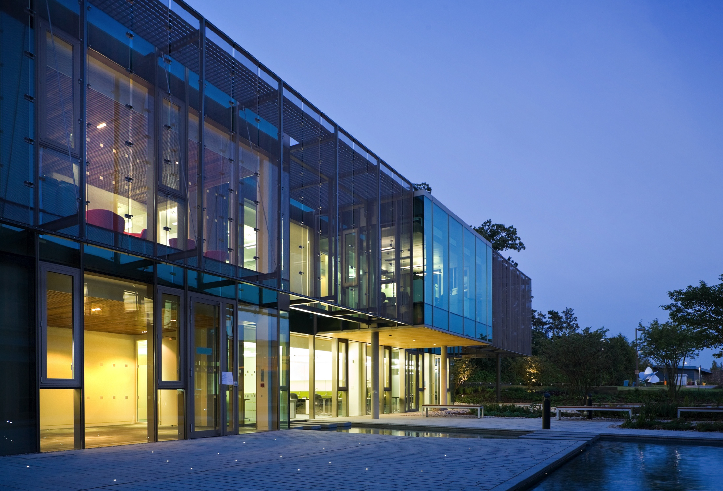









Ensembl Acknowledgements
The Entire Ensembl Team
Daniel R. Zerbino¹, Premanand Achuthan¹, Wasiu Akanni¹, M. Ridwan Amode¹, Daniel Barrell^{1,2}, Jyothish Bhai¹, Konstantinos Billis¹, Carla Cummins¹, Astrid Gall¹, Carlos García Giroń¹, Laurent Gil¹, Leo Gordon¹, Leanne Haggerty¹, Erin Haskell¹, Thibaut Hourlier¹, Osagie G. Izuogu¹, Sophie H. Janacek¹, Thomas Juettemann¹, Jimmy Kiang To¹, Matthew R. Laird¹, Ilias Lavidas¹, Zhicheng Liu¹, Jane E. Loveland¹, Thomas Maurel¹, William McLaren¹, Benjamin Moore¹, Jonathan Mudge¹, Daniel N. Murphy¹, Victoria Newman¹, Michael Nuhn¹, Denye Ogeh¹, Chuang Kee Ong¹, Anne Parker¹, Mateus Patricio¹, Harpreet Singh Riat¹, Helen Schuilenburg¹, Dan Sheppard¹, Helen Sparrow¹, Kieron Taylor¹, Anja Thormann¹, Alessandro Vullo¹, Brandon Walts¹, Amonida Zadissa¹, Adam Frankish¹, Sarah E. Hunt¹, Myrto Kostadima¹, Nicholas Langridge¹, Fergal J. Martin¹, Matthieu Muffato¹, Emily Perry¹, Magali Ruffier¹, Dan M. Staines¹, Stephen J. Trevanion¹, Bronwen L. Aken¹, Fiona Cunningham¹, Andrew Yates¹ and Paul Flicek^{1,3}
¹European Molecular Biology Laboratory, European Bioinformatics Institute, Wellcome Genome Campus, Hinxton, Cambridge CB10 1SD, UK, ²Eagle Genomics Ltd., Wellcome Genome Campus, Hinxton, Cambridge CB10 1DR, UK and ³Wellcome Trust Sanger Institute, Wellcome Genome Campus, Hinxton, Cambridge CB10 1SA, UK
Funding
Co-funded by the European Union

